Slide 1


Case Study: Collection Manager
Derivation Process Explanation

Slide 2
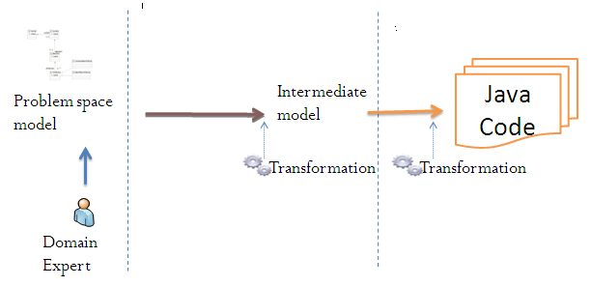
Multi-staged configuration of products
Domain application model created by a domain expert.
MDE develops products departing from domain application models which conform to domain application metamodels, and that are derived using a set of model transformations. These model transformations may require various stages. At each stage, domain application models are automatically transformed to include more details.

Slide 3
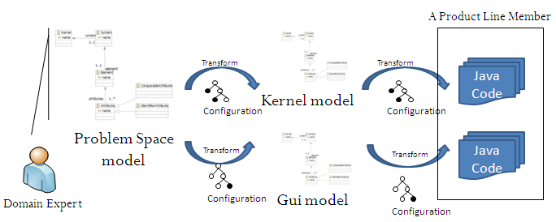
Derivation process
To configure a product, a Domain Expert creates a Problem Space Model.
In this case study, the problem space model is transformed into a kernel model and a GUI model accordingly.
Finally, the kernel and GUI models are transformed to source code.

Slide 4
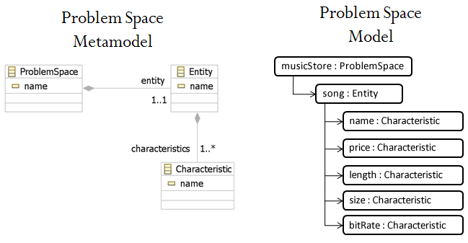
Problem space creation
Problem Space models represent collections.
Entity: It is the element to be managed.
Characteristic: It is a property of the Entity.
This is an example of a Problem Space model for a collection of songs

Slide 5
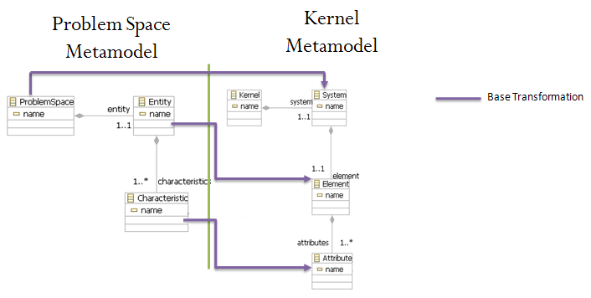
Derivation process: Problem space to kernel

Slide 6
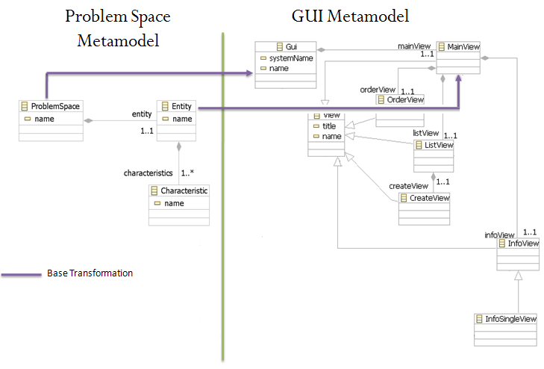
Derivation process: Problem space to GUI

Slide 7
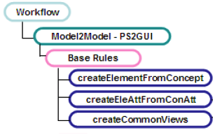
Workflow
A model transformation consists of a set of transformation rules; each transformation rule is responsible for producing a part of the final product. To derive a complete product, we assembly the transformation rules in a workflow which determines the order in which the individual parts are produced and assembled.

Slide 8
© 2011

